Slide 1


LOGISTIC REGRESSION: INTUITION
Linear regression is used to predict outputs on a continuous spectrum.
Example: predicting revenue based on the outside air temperature.
Logistic regression is used to predict binary outputs with two possible values labeled "0" or "1"
Logistic model output can be one of two classes: pass/fail, win/lose, healthy/sick
Hours Studying | Pass/Fail
1 | 0
1.5 | 0
2 | 0
3 | 1
3.25 | 0
4 | 1
5 | 1
6 | 1
PASS/FAIL
LINEAR MODEL
HOURS OF STUDYING

Slide 2
LOGISTIC REGRESSION: INTUITION
Linear regression is not suitable for classification problem.
Linear regression is unbounded, so logistic regression will be better candidate in which the output value ranges from 0 to 1.
LINEAR MODEL
PASS/FAIL
LOGISTIC REGRESSION MODEL
HOURS OF STUDYING

Slide 3
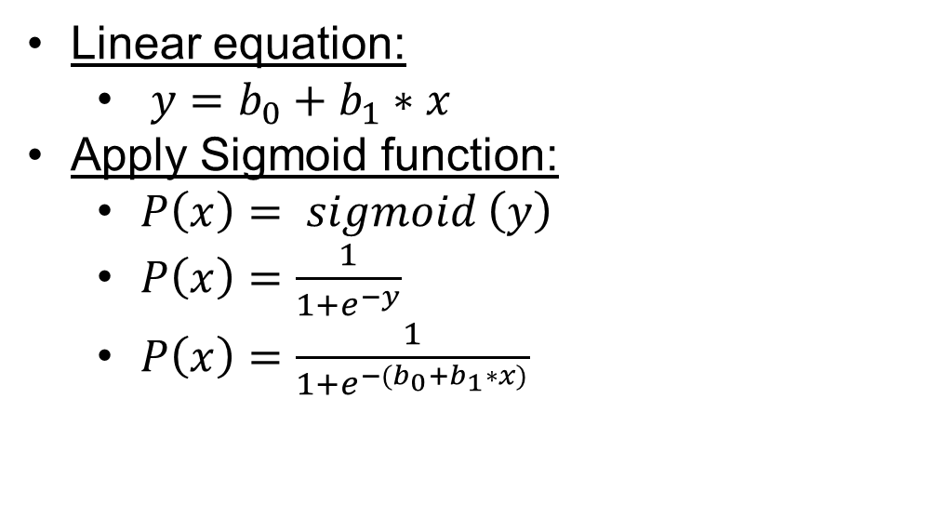
LOGISTIC REGRESSION: SOME MATH
Logistic regression algorithm works by implementing a linear equation first with independent predictors to predict a value.
We then need to convert this value into a probability that could range from 0 to 1.
Linear equation:
$y=b_{0}+b_{1}∗x$
Apply Sigmoid function:
$P\left(x\right)= sigmoid \left(y\right)$
$P\left(x\right)=\frac{1}{1+e^{−y}}$
$P\left(x\right)=\frac{1}{1+e^{−(b_{0}+b_{1}∗x)}}$
PASS/FAIL
LOGISTIC REGRESSION MODEL
HOURS OF STUDYING

Slide 4
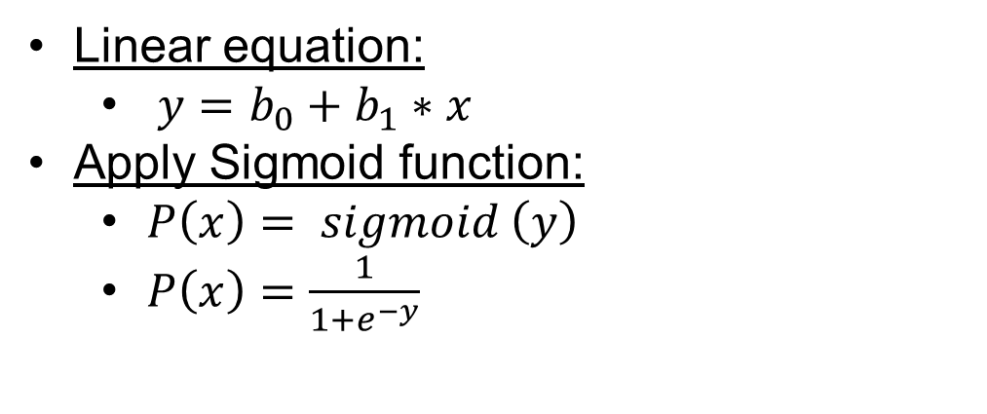
LOGISTIC REGRESSION: FROM PROBABILITY TO CLASS
Now we need to convert from a probability to a class value which is “0” or “1”.
Linear equation:
$y=b_{0}+b_{1}∗x$
Apply Sigmoid function:
$P\left(x\right)= sigmoid \left(y\right)$
$P\left(x\right)=\frac{1}{1+e^{−y}}$
Class 1
LOGISTIC REGRESSION MODEL
PASS/FAIL
0.5
Class 0
THRESHOLD
HOURS OF STUDYING

